Slide 1
CSC101
Lecture 1
Introduction

Slide 2
Course Goals
Learn to develop algorithms to solve problems.
Improve analytical and problem-solving skills.
Develop sound logical reasoning skills.
Learn to implement algorithms in C++.

Slide 3
What is Computer Science?
Computer Science is the study of computers and computational systems. Unlike electrical and computer engineers, computer scientists deal mostly with software and software systems; this includes their theory, design, development, and application.

Slide 4
Subfields of Computer Science
Algorithms and Data Structures.
Artificial intelligence.
Computer systems and networks.
Cyber Security.
Database systems.
Human computer interaction.
Machine learning.
Software engineering.
Bioinformatics and theory of computing.

Slide 5
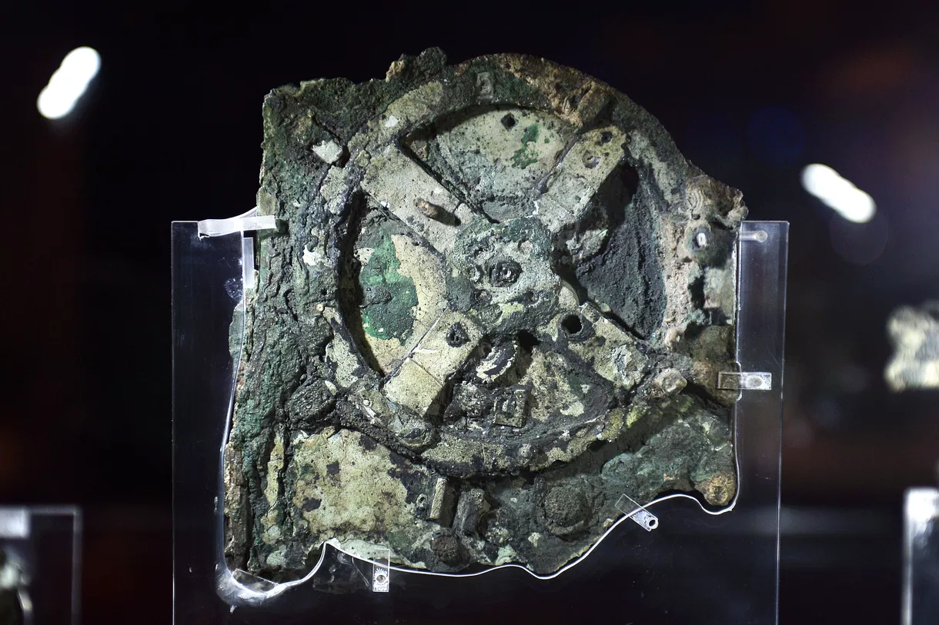
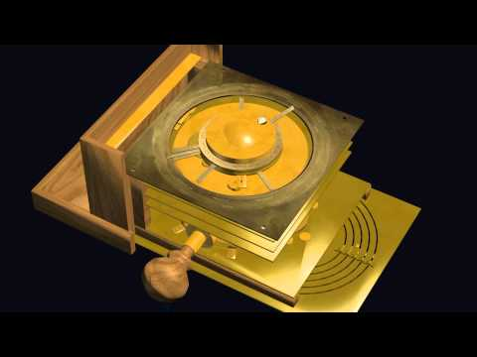
History of Computing Devices Continued
The Antikythera mechanism is an ancient Greek analog computer which could predict the astronomical position, solar eclipse, cycle of Olympic game and many more.

Slide 6
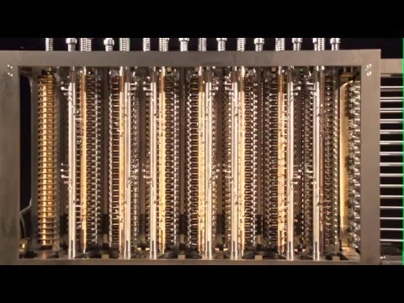
History of Computing Devices Continued
Charles Babbage and Ada Lovelace together are often thought of as the founders of modern computing. Babbage invented the difference engine. Ada Lovelace is known for designing the first algorithm and in this sense she is considered as a pioneer in modern programming.

Slide 7
History of Computing Devices Continued
In 1837 Charles Babbage proposed the Analytical Engine which was successor to Babbage’s Difference Engine. The Analytical Engine incorporated an arithmetic logic unit, control flow in the form of conditional branching and loops, and integrated memory, making it the first design for a general-purpose computer that could be described in modern terms as Turing-complete.

Slide 8
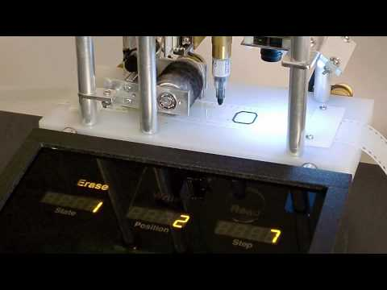
History of Computing Devices Continued
Turing Machine was invented by Alan Turing in 1936.

Slide 9
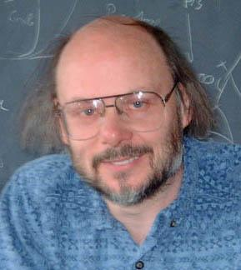
C++
Bjarne Stroustrup (1950-) designed C++.
First released in 1985.
Supports both object-oriented and procedural programming.

Slide 10
Writing your first Program
Download Code::Blocks from http://www.codeblocks.org/downloads/26
Open Code::Blocks and open a c++ file.
A sample program #include <iostream> using namespace std;
int main(){
cout<<"hello world";
return 0;
}

Slide 11
Number Systems
There are several number systems which we usually use such as decimal, binary, octal and hexadecimal number system
- Decimal number system has the value of base as 10
- Binary number system has the value of base as 2
- Octal number system has the value of base as 8
- Hexadecimal number system has the value of base as 16
We are most familiar with the decimal number system

Slide 12
Distinct Digits in Each Number System
Number System |  |  | Different Digits in Number System
Decimal |  |  | 0 | 1 | 2 | 3 | 4 | 5 | 6 | 7 | 8 | 9
Binary |  |  | 0 | 1
Octal |  |  | 0 | 1 | 2 | 3 | 4 | 5 | 6 | 7
Hexadecimal |  |  | 0 | 1 | 2 | 3 | 4 | 5 | 6 | 7 | 8 | 9 | A | B | C | D | E | F

Slide 13
Corresponding Digits in Number Systems
Number System |  |  | Different Digits in Number System
Decimal |  |  | 0 | 1 | 2 | 3 | 4 | 5 | 6 | 7 | 8 | 9 | 10 | 11 | 12 | 13 | 14 | 15 | 16
Binary |  |  | 0 | 1 | 10 | 11 | 100 | 101 | 110 | 111 | 1000 | 1001 | 1010 | 1011 | 1100 | 1101 | 1110 | 1111 | 10000
Octal |  |  | 0 | 1 | 2 | 3 | 4 | 5 | 6 | 7 | 10 | 11 | 12 | 13 | 14 | 15 | 16 | 17 | 20
Hexadecimal |  |  | 0 | 1 | 2 | 3 | 4 | 5 | 6 | 7 | 8 | 9 | A | B | C | D | E | F | 10

Slide 14
Conversion from Decimal to Binary
Convert (26)₁₀ into binary number
Division | Quotient | Generated Remainder
26 2 | 13 | 0
13 2 | 6 | 1
6 2 | 3 | 0
3 2 | 1 | 1
1 2 | 0 | 1

Slide 15
Conversion from Decimal to Binary
Convert (26)₁₀ into binary number
Division | Quotient | Generated Remainder
26 2 | 13 | 0
13 2 | 6 | 1
6 2 | 3 | 0
3 2 | 1 | 1
1 2 | 0 | 1
(11010)₂

Slide 16
Conversion from Decimal to Hexadecimal
Convert (348)₁₀ into hexadecimal number
Division | Quotient | Generated Remainder
348 16 | 21 | 12 -> C
21 16 | 1 | 5
1 16 | 0 | 1
(15C)₁₆

Slide 17
Conversion from Binary to Decimal
Convert (10110)₂ into decimal
4 3 2 1 0
1 0 1 1 0
= 1 x 2⁴ + 0 x 2³ + 1 x 2² + 1 x 2¹ + 0 x 2⁰
= 16 + 0 + 4 + 2 + 0
= (22)₁₀
Position of digit

Slide 18
Conversion from Binary to Hexadecimal
Convert (111011)₂ into hexadecimal
Grouping 4 bits 11 1011
0011 1011
Hexadecimal equivalent 3 B
= (3B)₁₆

Slide 19
Reference
https://en.cppreference.com/
http://www.cplusplus.com/

